Slide 1
Analysis and Prediction of Housing Prices
Submitted By::
Devendra Samatia (15ucs037)
Divyanshu jhawar (15ucs040)
Vinay Jain (15ucs055)

Slide 2
What is the problem ?
Major Problem scenario tackled here is the prediction of collective housing prices.
We will also see how weak features affect the overall prediction algorithm and changes needed to make to satisfy the desired outcome.

Slide 3
What’s new in this problem ?
Previously the solutions proposed were predicting the price of a particular house given its internal features, our problem tackles the issues of locality comprising of houses in an area.
Dealing with features which are similar in any locality.
This lead to a problem of too many weak features and very less correlation to final outcome which is median house value.

Slide 4
Why is it necessary to address this problem ?
Because it can be useful for planning purposes for governmental organisations.
Investment decision for companies and other building firms.
Useful in macro economical aspects like GDP,money flow, purchasing power parity and inflation.

Slide 5
Other related works
According to Seutin and Jones, housing prices can be predicted using Neural Networks and Random Forest using internal special features like condition,view of house and waterfront,etc.
If hedonic modelling techniques to estimate housing value like inflation rates, area importance,etc.

Slide 6
Abstract
Problem of building a prediction model for the on California housing data-set.
Augmentation the efficiency of the prediction cost function.
Visualization of how data varies and affects the price.
Analyzing and applying various feature selection methods .
Applied the machine learning algorithms like ensembles to sorted data-set.

Slide 7
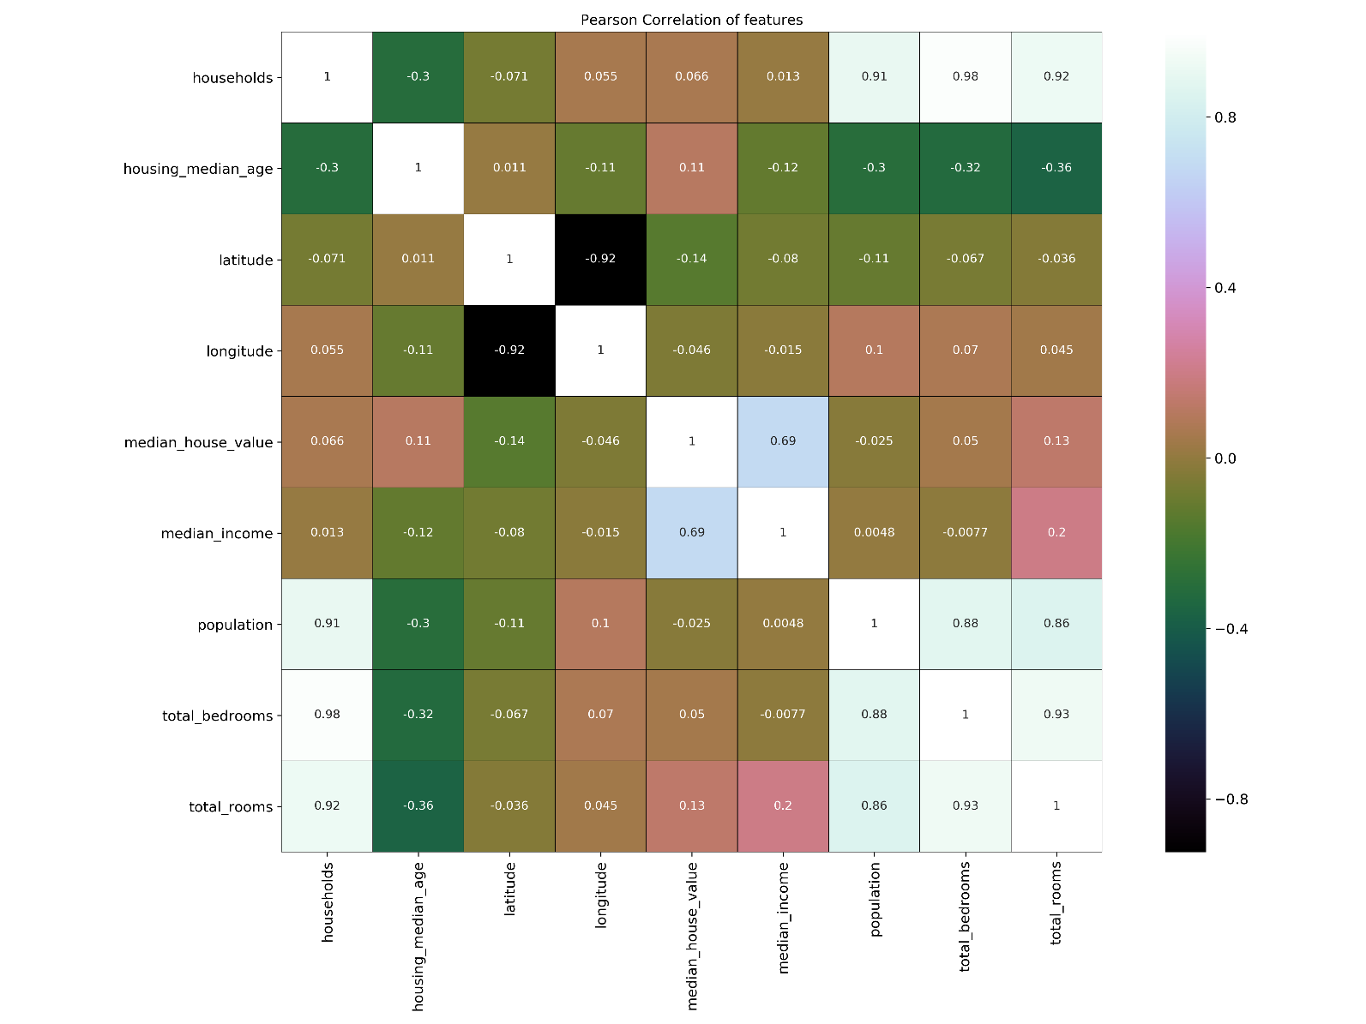
Feature Engineering and Selection
We made correlation matrix between various feature to check their dependency and influence upon other features and expected labels.
Here we see that population, total bedrooms and total rooms are very dependent on each other.

Slide 8

Feature Selection and Engineering
This leads to our decision to make new features which are connected to each other.
So we made features like $\text{Totalroomsperhousehold}$,Totalpopulationperroom, Totalbedroomperroom.

Slide 9
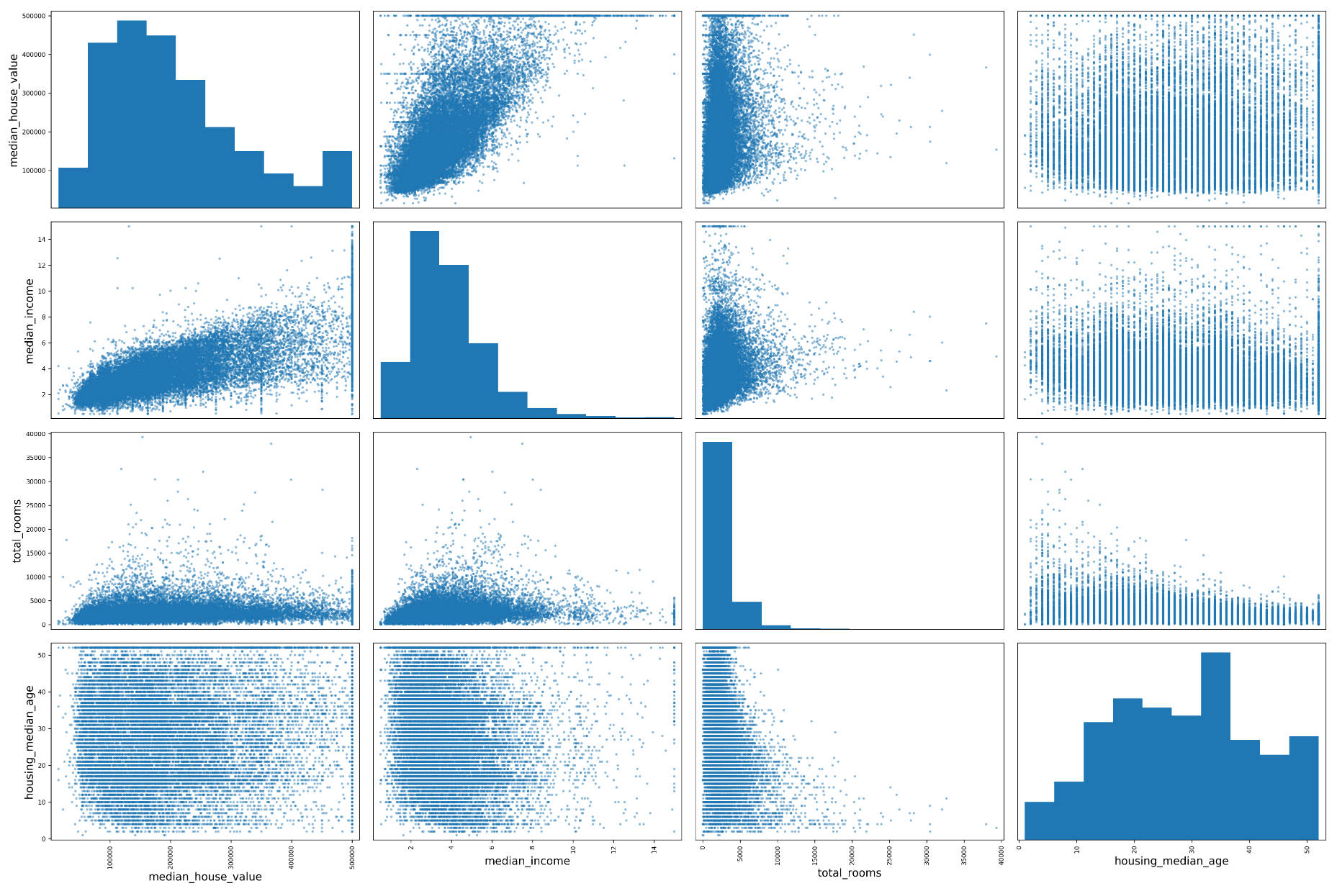
Feature Selection and Engineering
Another factor was how the features were affecting the overall outcome label

Slide 10
Feature Selection and Engineering
This is an early indication that regressor algorithm alone would not be able to accurate function with high probability.

Slide 11
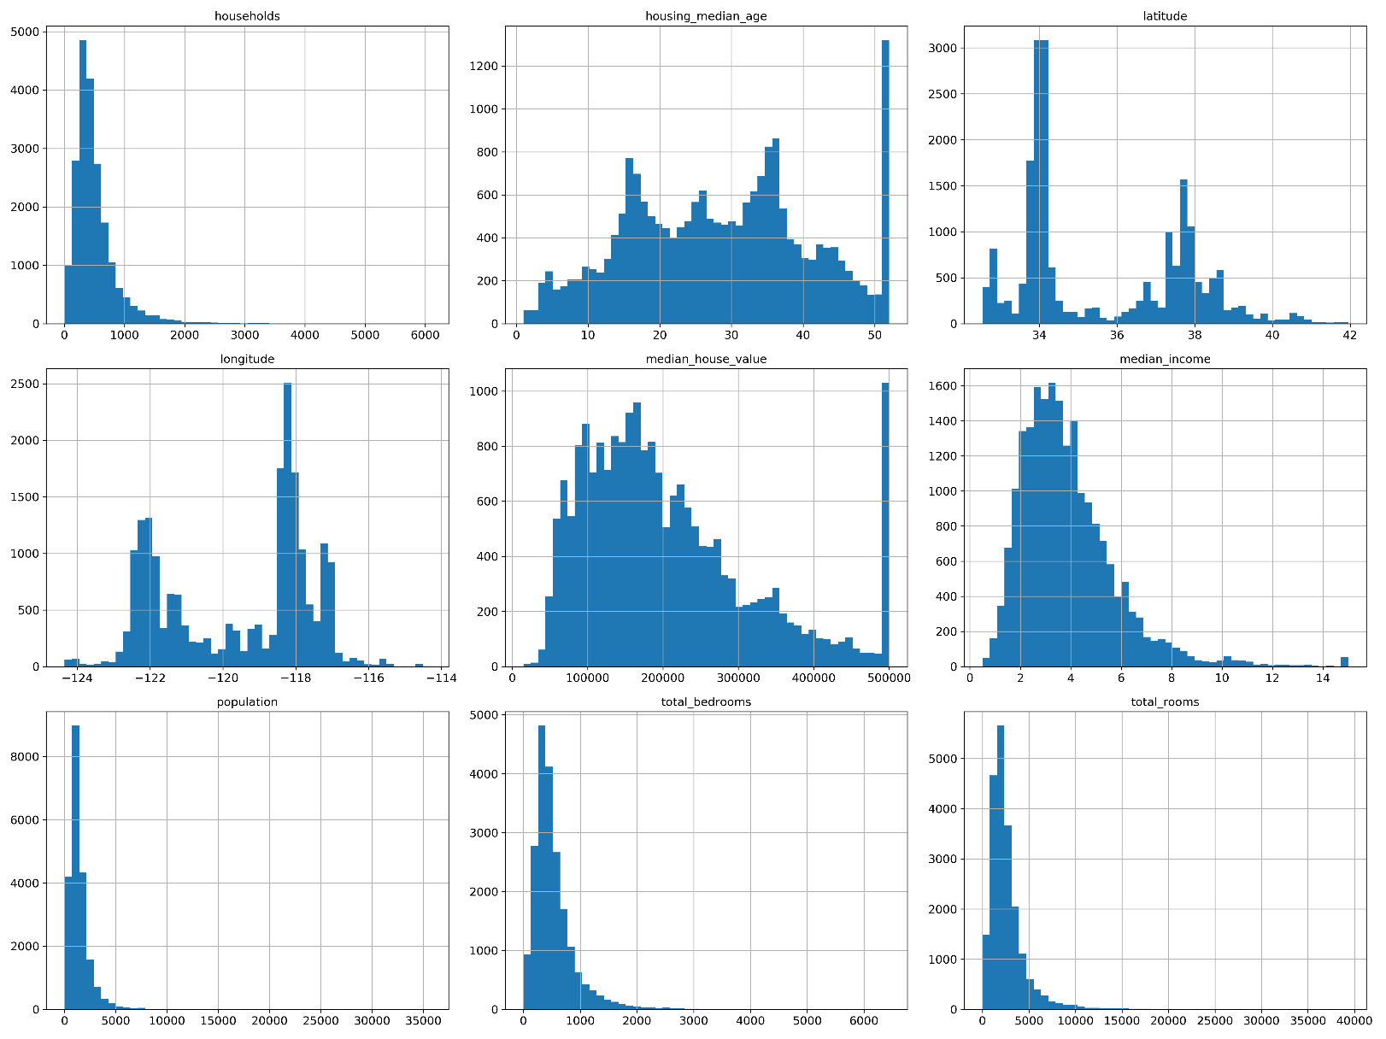
Feature Engineering and Selection
Another possibility can be that either the log of the function or cube of the function can be very effective.

Slide 12
Feature Selection and Engineering
From the previous piece of information we know that new features such as log of rooms ,longitude * longitude , latitude * latitude , longitude* latitude can be important feature not to be missed out.

Slide 13
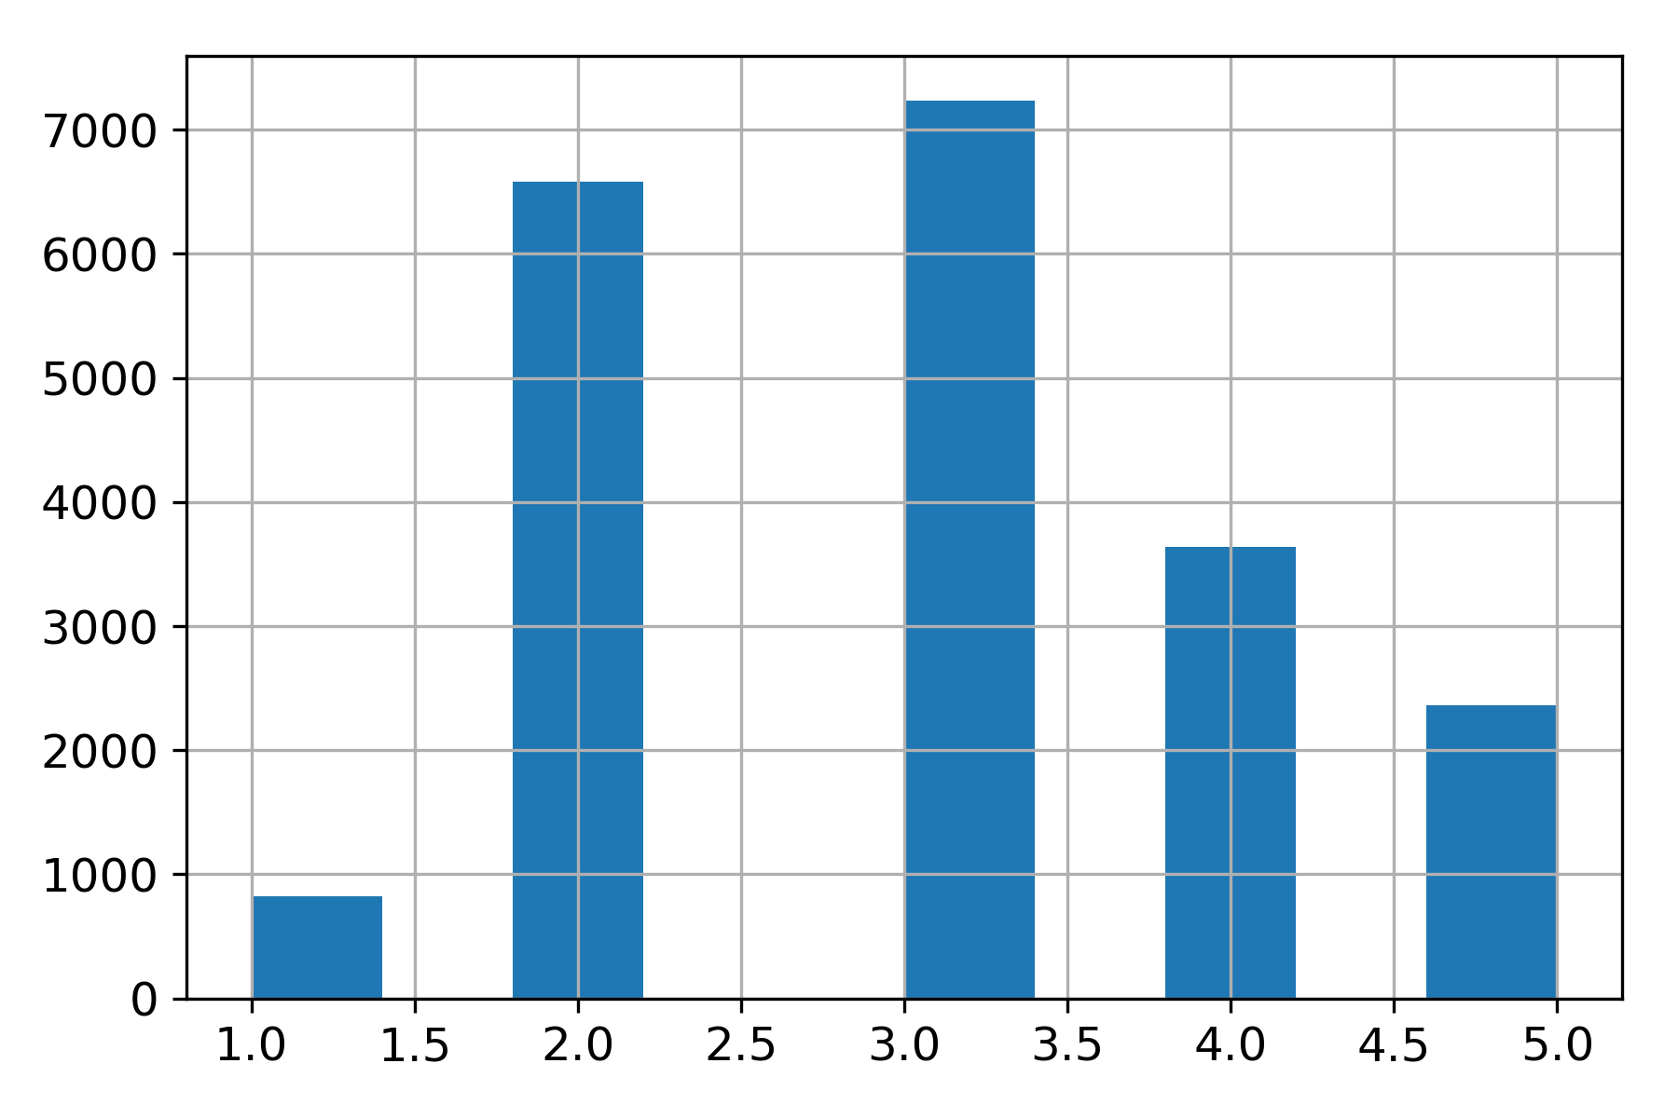
Training and Test Split
Splitting is an important part of prediction. We have here used stratified split according to the most important feature medium income to split it.

Slide 14

Training and Test Split
We divided it into 5 section if income range by $\frac{maxIncome −minIncome}{n −1}$.
Then each section was divided into 70:30 ratio.
It was done keeping in mind the example that 50% male and 40% female should be preserved in training as well as test set.

Slide 15
Pipeline Transformation
The main reason to make a pipeline is that we can club many different functions and use them differently on various machine learning algorithm which increase reusability.
We had 2 types of data to clean and modify such as numerical data and categorical data which needs to be transformed into numerical data to be used.

Slide 16
Pipeline Transformation
Numerical Data
Imputer
Attribute Adder
Standard Scalar
Data
Prepared Data
Categorical Data
One Hot Dense Encoder

Slide 17
Design and Implementation
How the data was scrutinized according to the needs of the project, the libraries and algorithm.
Interpret the characteristics of the prediction model.
Data Preparation
Utilization of Data

Slide 18
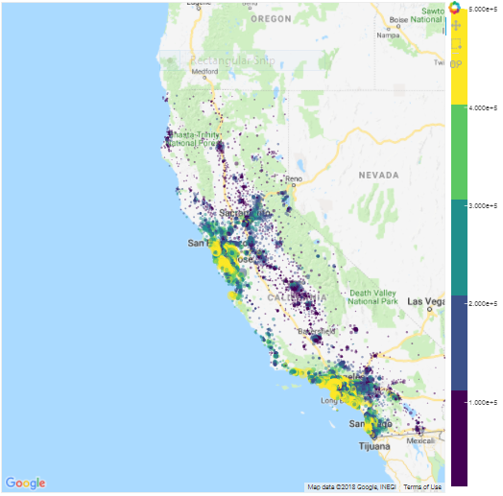
Data Preparation
Every feature is proffering information of the total sum of house values in a square area containing 1000 houses.
Feature scaling was done to adjust into the range [-1,1] with a mean of 0.
We used Median as Imputer for missing values in our data-set.

Slide 19
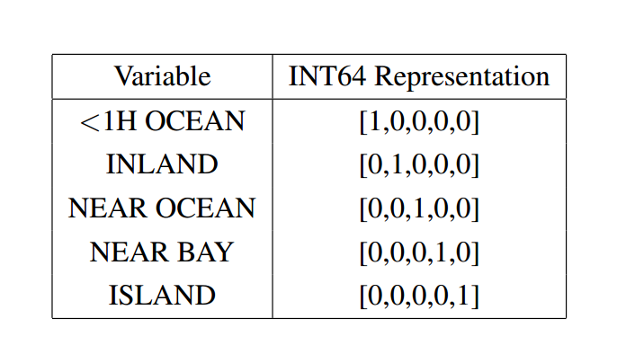

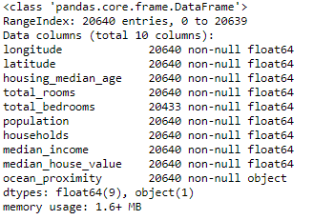
1. Data Preparation
10 features overall out of which nine features are of data-type float64 and rest one is of type object.
'Ocean Proximity' was categorical object datatype.
Ocean Proximity with 5 variable, was converted to INT64 representation
There were null entries in the 207 entries out of 20640 samples for feature ’total_bedrooms’.
We used Median as Imputer for null values.

Slide 20
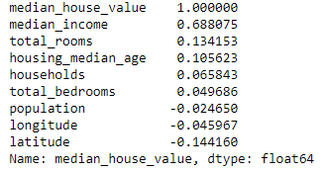
2. Data Utilization
To analyze the how each feature affects other, we used "Correlation Matrix" using Pearson Method.
The matrix got from correlating median_house_value with all the 8 features (excluding ocean_proximity) only median_income was affecting it much, 68.8% rest all were less than 15%.
Now we separated the data-set into 70:30 for training and testing. For that we shuffled the data on the basis of median_income.

Slide 21
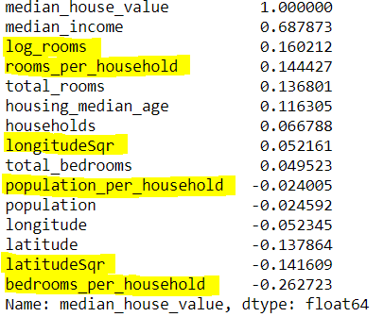

2. Data Utilization
We created some new features from the data-set.
$\text{Totalroomsperhousehold}$ =$\frac{totalrooms}{households}$
Totalbedroomperroom = $\frac{totalbedrooms}{totalrooms}$
Totalpopulationperperroom = $\frac{totalpopulation}{totalrooms}$
Apart from these, some others were created like "log_rooms", "longitudesqr" and "latitudesqr“

Slide 22
Prediction Model Implemented
Linear Regression
Ridge Regression
Random Forest
Multi Layer Perceptron
Gradient Boosting

Slide 23


Linear Regression implementation
It works on step by step moving towards minimizing the cost function(J) linearly.
Where predicted price is calculated by a hypothesis function {h}, thetas {set of constants} and X {input data}.
Linear Regression uses Gradient Descent algorithm to update the constant(theta).

Slide 24
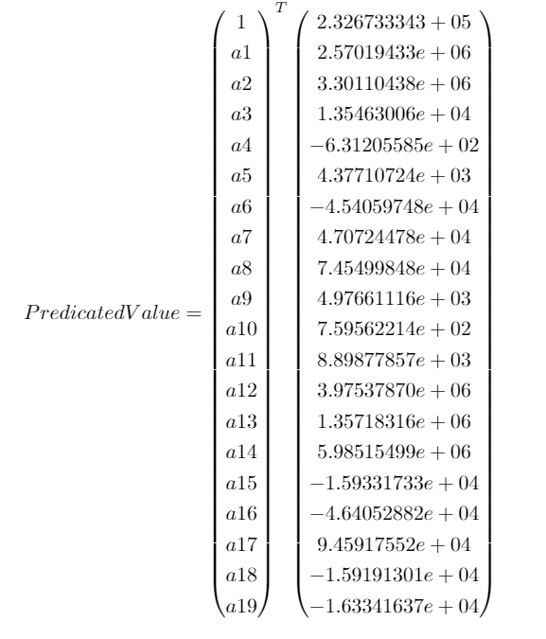
Linear Regression implementation
We added the square of longitude and latitude and product of latitude and longitude as three additional features.
We calculated the values of the coefficients using gradient descent

Slide 25
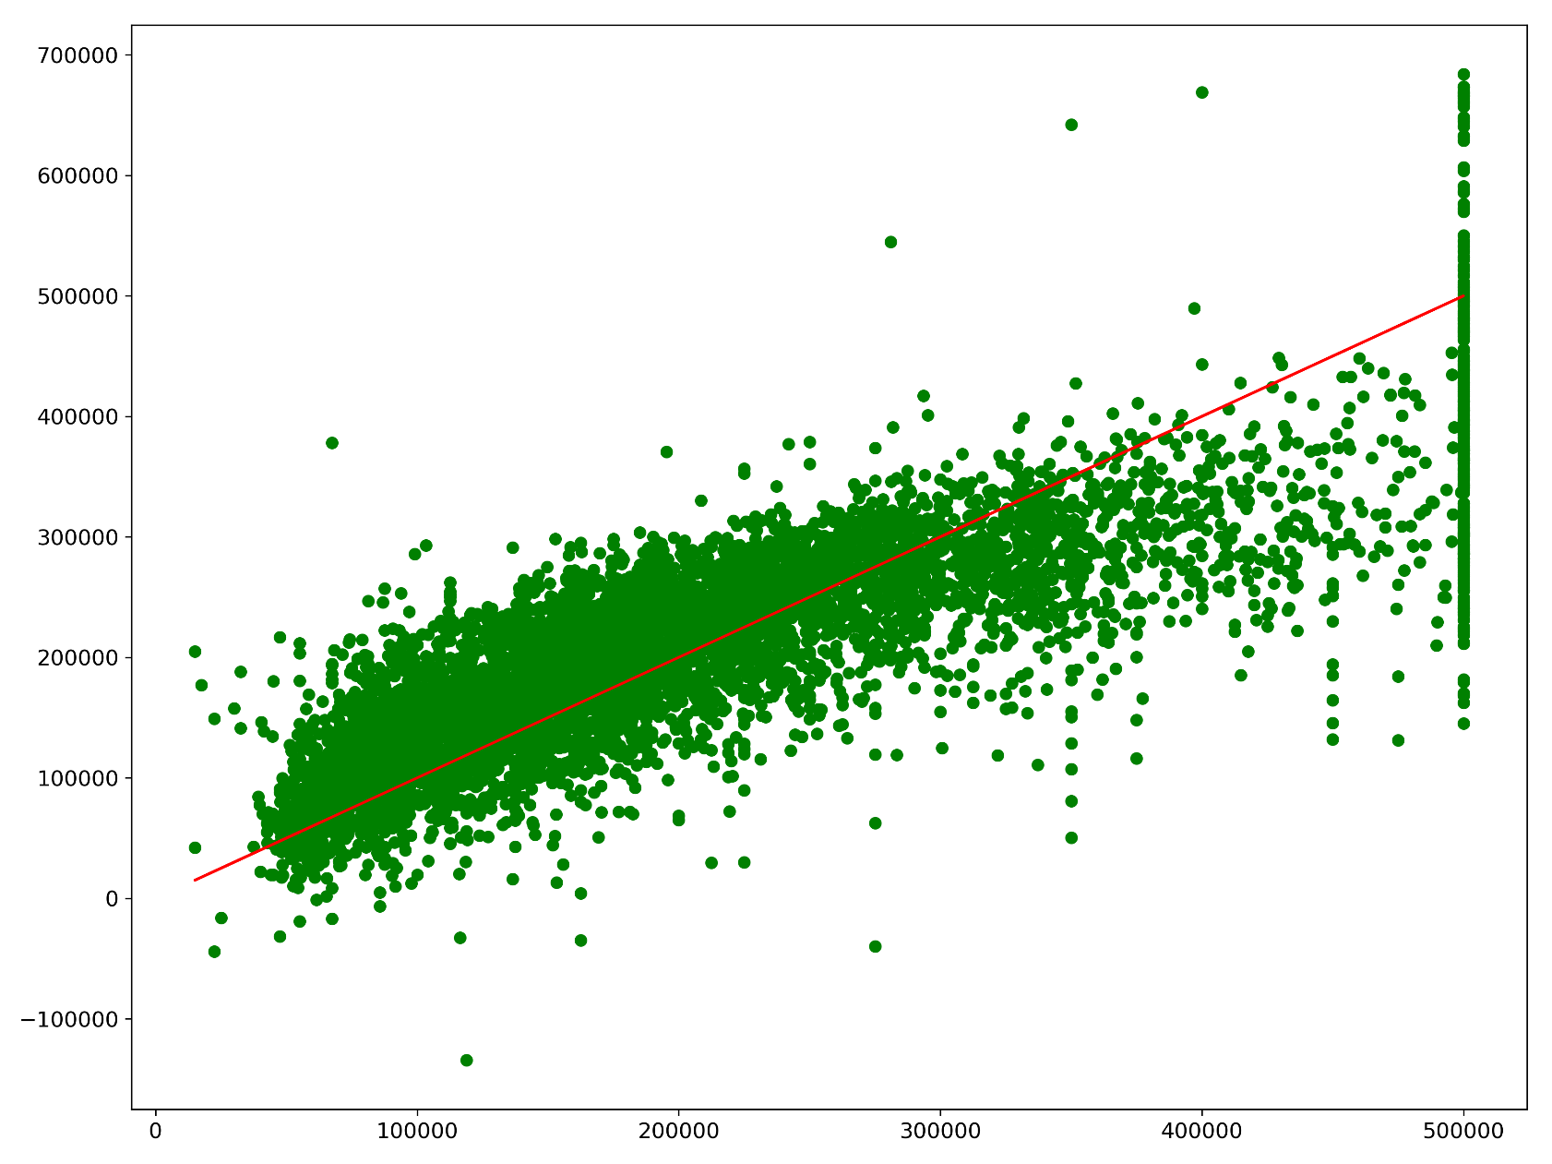
Linear Regression Implementation

Slide 26

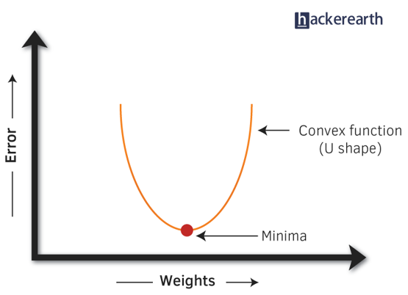
Gradient Descent
Alpha (∝) here is chosen to be small value, which implies taking small steps towards the minimizing the cost and eventually to the minima of the graph. Minima here is global minima which is the target point or the minimum error point.
If alpha is chosen too large it may jump from one side of graph to other and never ever go towards the minima of the function.

Slide 27
Gradient Descent
If alpha is chosen too small it may take very large time to finally reach the minima of the graph.
So the ideal choice of alpha is between 0 and 3. Which delivers the best results to reach the minimum error on the minima.
Number of iteration(m) are also important, as on each iteration the theta is updated, that is error is minimized (or the same) on each iteration.

Slide 28
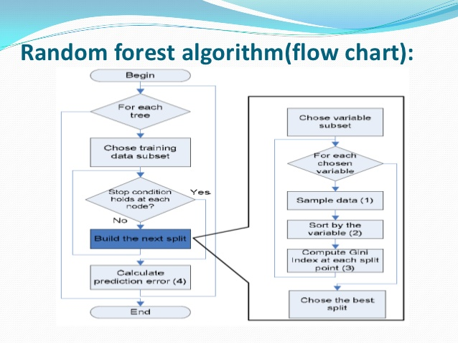

Random Forest
It creates a forest on some random values and then try to update on each iteration .
it provides is that it helps in fighting the over fitting of model over the data if the number of tress are large enough.
a data-set X = x1 , x2, ...xn with labels Y = y1, y2 ... yn is bagged continuously B times. Now, Xb and Yb be the set replacedfrom X and Y, where b = 1, 2, ... B. And let training a tree on Xb and Yb be called fb.
Predictions for unseen samples x’ can be made by averaging the predictions from all the individual regression trees on x’.

Slide 29
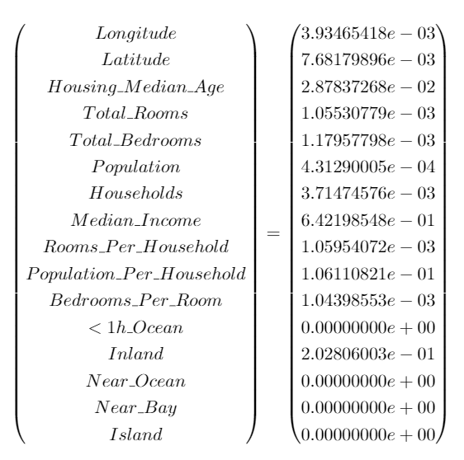
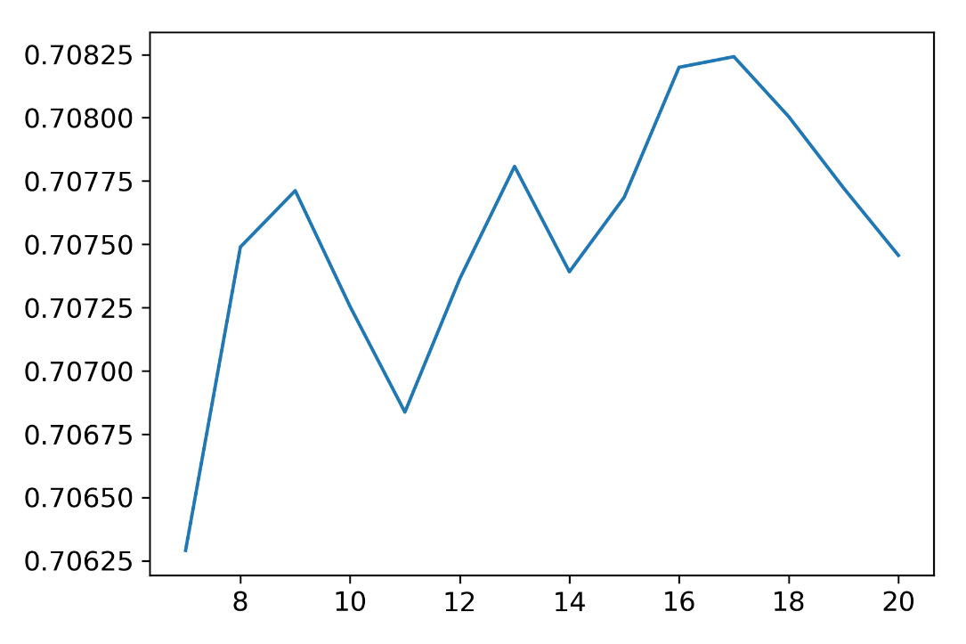
Random Forest
The optimal result is obtained with parameters such as no of trees in the forest is19, splitting criteria as mean squared error, no of max features is 7, max depth of any tree is 5

Slide 30
Multi Layer Perceptron
Multi-layer perceptron is a type of artificial neural network which can be viewed as a type of logistic regression (where the dependent variable is categorical).
MLP uses supervised learning technique called Back-Propagation for training the artificial network. Here we used 3 hidden layers with 400, 100 and 10 nodes in the respective nodes.
It works by separating the data that are not linearly separable. It generates a function that acts as linear classifier. A perceptron produces an output on the basis of the inputs.

Slide 31

Multi Layer Perceptron
Here w is the vector of weights, x is the input and b is the bias and the function is non-linear activation function.

Slide 32
Backpropagation
Back propagation is the most widely and best working neural network till today. It changes the weights and bias after each iteration going backwards so that they get closer to the target output, thereby minimizing the error of each neuron and the network as a whole. This involves some mathematical calculations which generate the desired result.

Slide 33
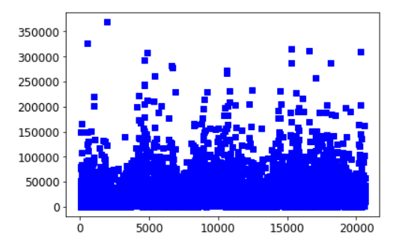




Gradient Boosting
$$F\left(x\right)=\hat{y}$$
On analysing our data set, we can see that it contains high bias and low variance.
Boosting techniques are such in which predictors are made to work sequentially and each predictor learn from the past predictor’s error and averages it with new predictors.
The primary aspiration of this algorithm is to define a differentiable loss function and minimize it.
We can see that the residual is the partial differential of gradient descent of learner.
$$MSE= {\left(y−\hat{y}\right)}^{2}$$
$$F_{m+1}=F_{m}+h(x)$$
$$h\left(x\right)=y −F(x)$$

Slide 34
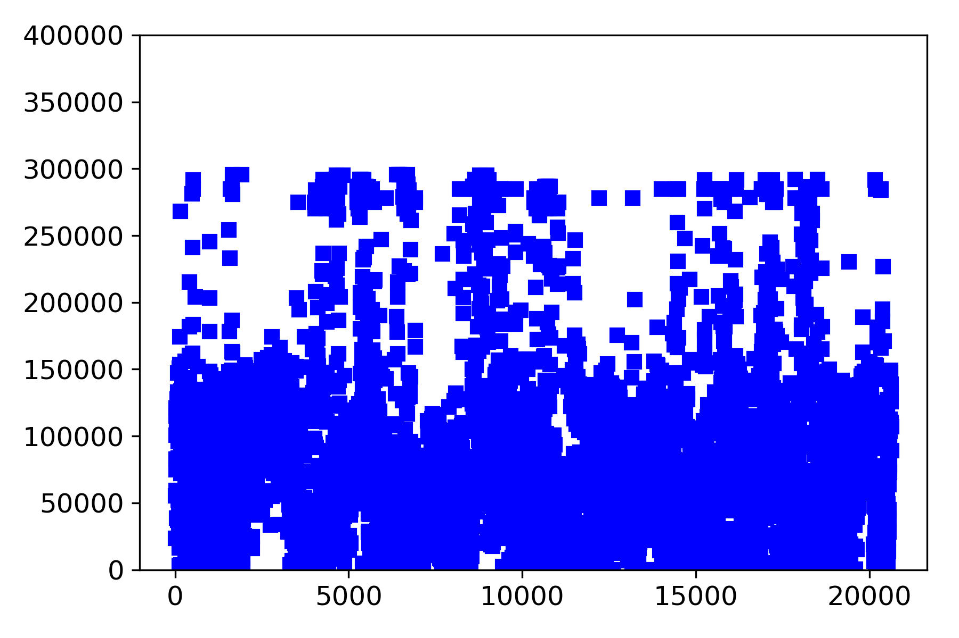
Gradient Boosting

Slide 35
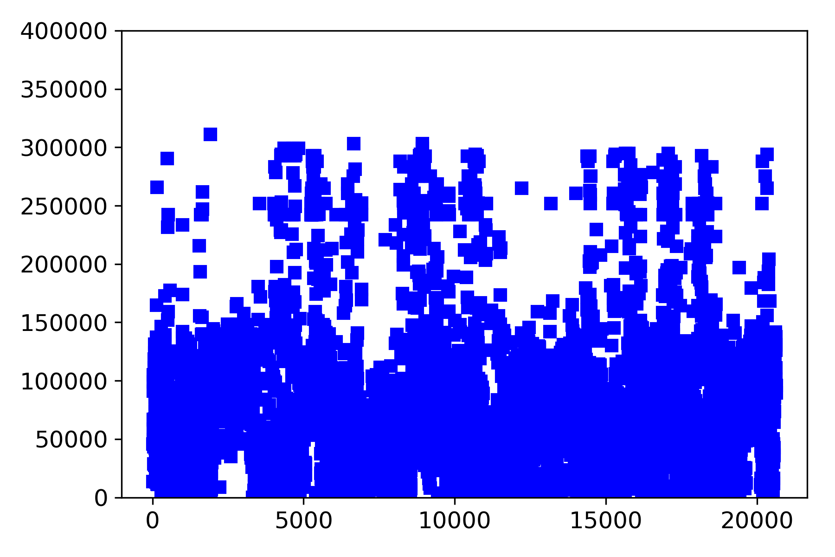
Gradient Boosting

Slide 36
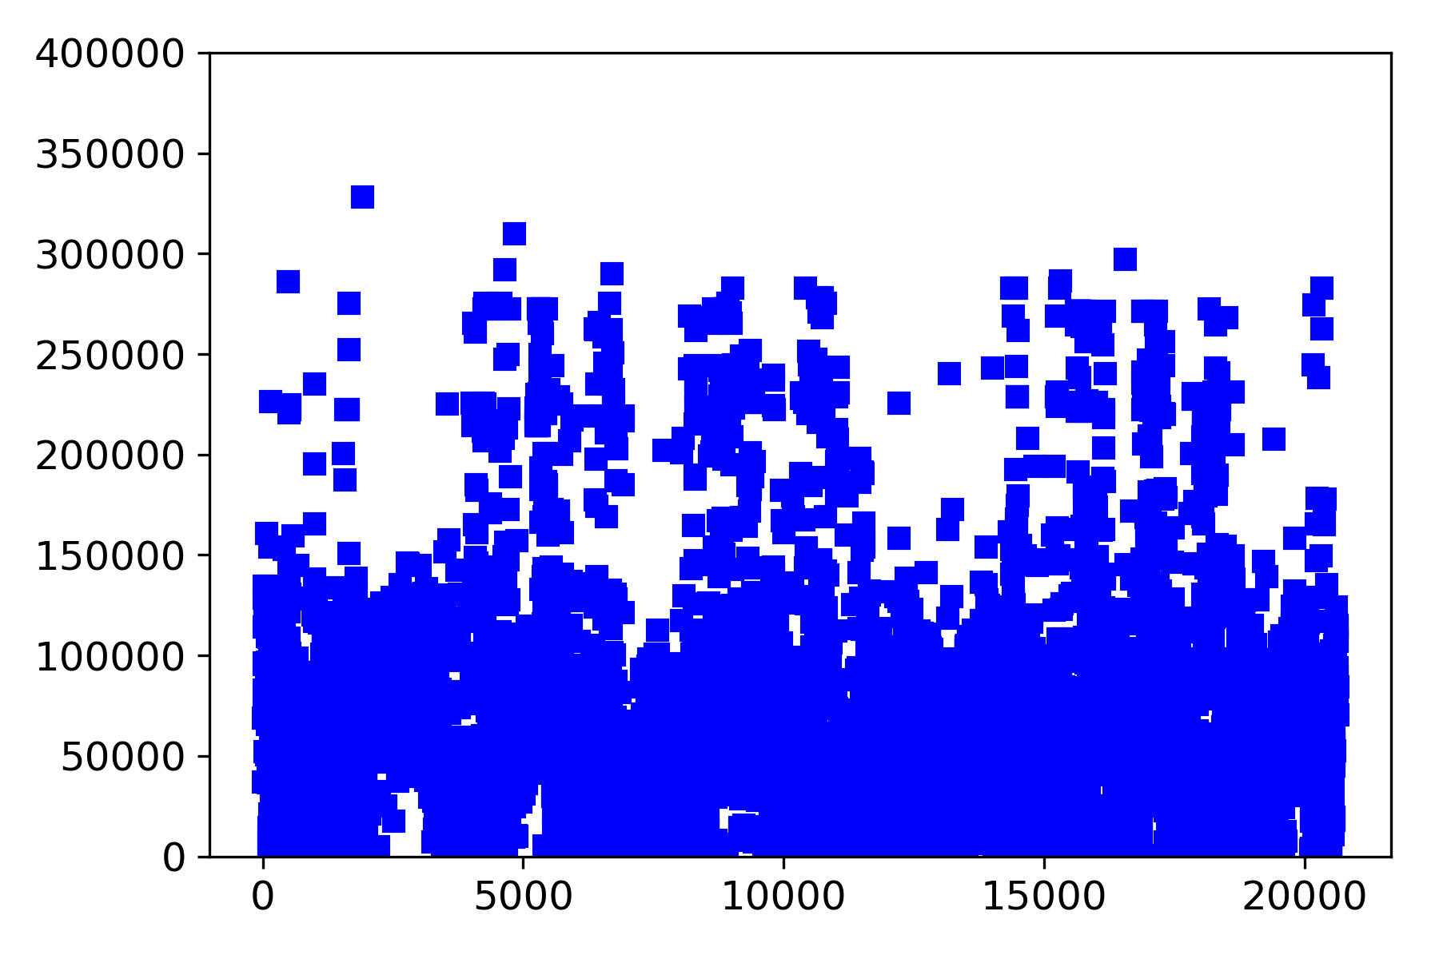
Gradient Boosting

Slide 37
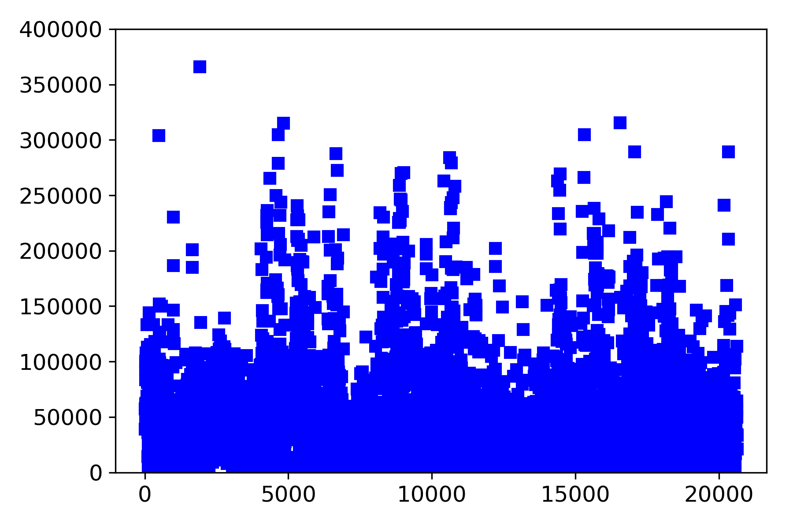
Gradient Boosting

Slide 38

Gradient Boosting

Slide 39
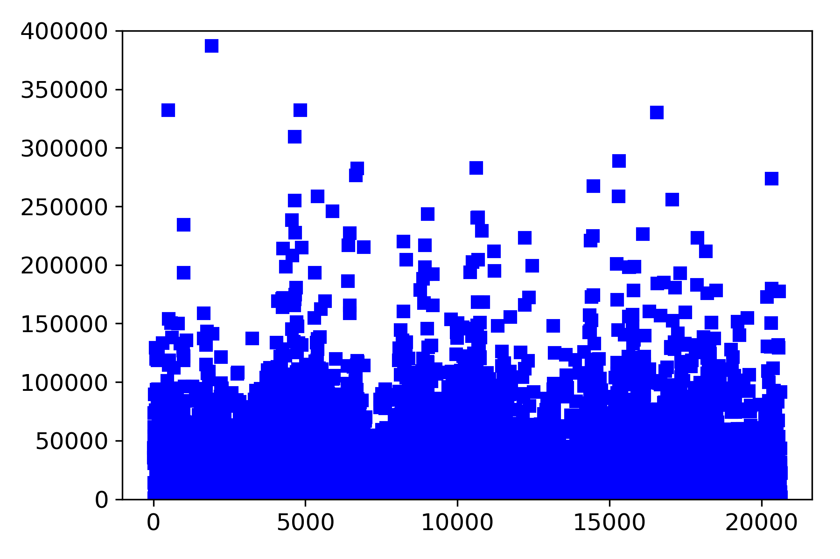
Gradient Boosting

Slide 40

Gradient Boosting

Slide 41
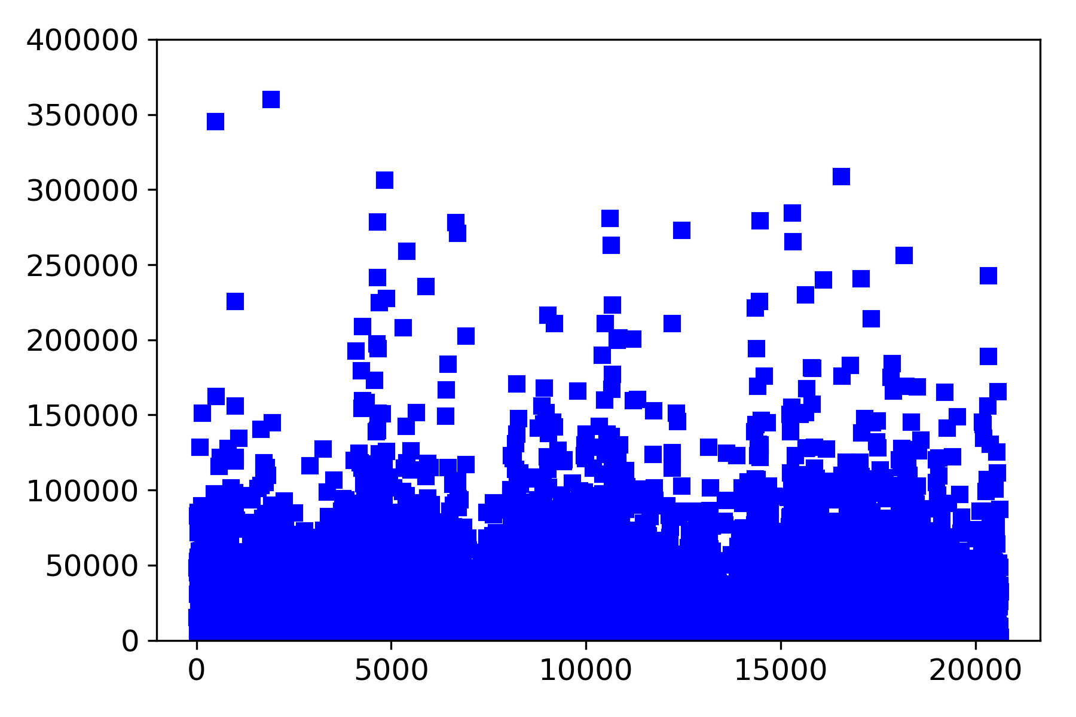
Gradient Boosting

Slide 42
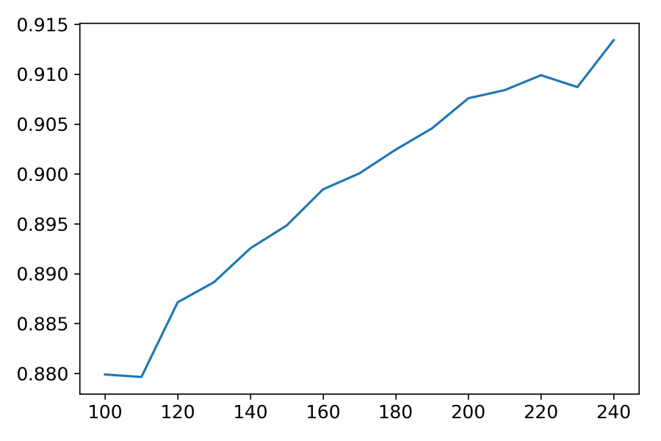
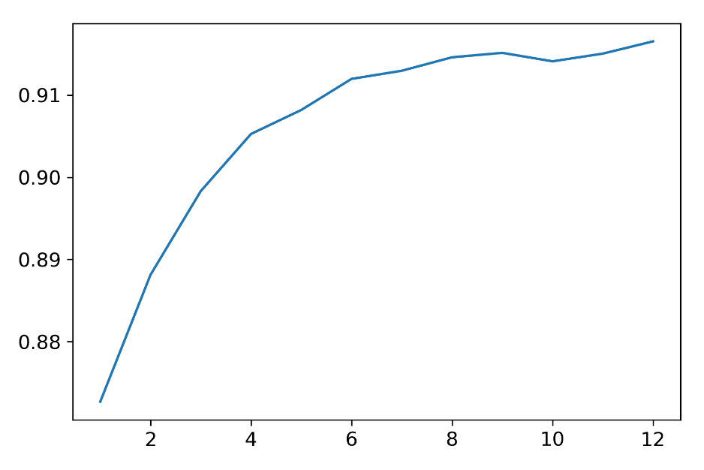
Gradient Boosting Implementation
we have used Grid Search Cross Validation to find the best parameters corresponding to gradient boosting.
Huber Loss is the combination of least squared regression and least absolute deviation. The learning rate is 0.1 and no of boosting stages is 210.

Slide 43

Regularization
The regularization is basically an improvement to the regression methods. It adds an extra term to the standard cost function to avoid the over-fitting of the data.
There are two types of regularization– Ridge and Lasso. We have used the Ridge regression technique.
It works by minimizing the values of those thetas that have very low impact or those that create more of noise. Here λ acts as a tuning parameter, that adjusts the values of constants such that it reduces the over-fitting problem.

Slide 44
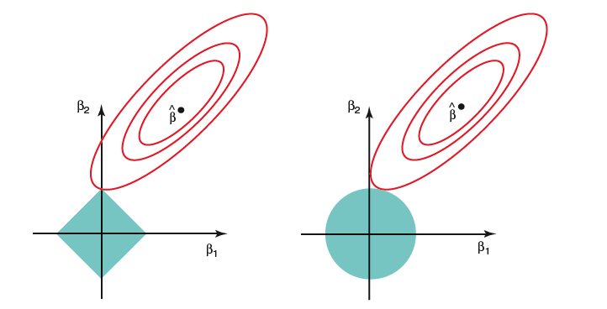
Regularisation

Slide 45
Regularisation
The ellipses in the picture represents the contours for the least square estimation for both Ridge Regression and Lasso Regression.
The picture represent the standard trade-off which we want for the value of "s", i.e. if the s is sufficiently large than the constraint region (blue square and blue circle) will estimate same as the least square regression.
Ridge regression provide penalty to all the parameters which tends towards zero (but not zero). In Lasso it is not so, in Lasso it can only work for the minimizing the most important features and making the coefficients of the others "zero".

Slide 46



Results
We have used Coefficient of Determination s our model’s accuracy evaluation strategy.
It can be calculated as :
is the mean of the observed data.
$y_{i}$ is the $ⅈ^{th}$ value of the label in the dataset
The total sum of squares
$$\overline{y}$$

Slide 47



$f_{i}$ is the predicted vale for the $ⅈ^{th}$ dataset.
The sum of squares of residuals
The Coefficient of determination is

Slide 48
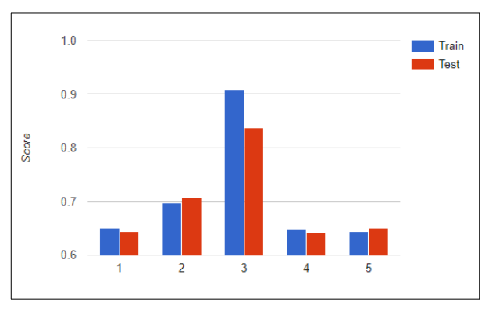
Score of the models
Linear Regression
Random Forest
Gradient Boosting
Neural Network
Ridge Regression

Slide 49
Conclusion
We come to conclusion that Gradient Boosting works best for us winning over Linear Regression, Random Forest, Neural Network and Ridge Regression.
Gradient Boosting provided coefficient of determination of 0.837. Next to it was Random Forrest.
When the features are works very well for that problem kind of problem.

Slide 50
Scope of further work
Computing more factors that influence the housing value.
Working with the validation set.
Detecting noise and reduce its impact.
Classification could have been more useful then regression.
Discovering other machine learning algorithms.
Integrating this prediction model to an android device to increase the scalability.

Slide 51
Thank you

